Slide 1



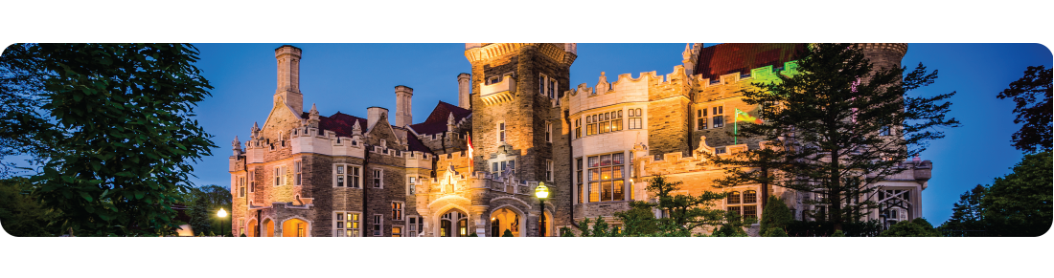
IEEE International Conference on Computer Communications
Nov. 16th-20th, 2020 // Jiulonghu Campus, Southeast University, Nanjing, China
A top ranked conference on networking in the research community.
A major conference venue for researchers to present and exchange significant and innovative ideas.

Slide 2

AGENDA
Opening Speech by President Fan Wang (IEEE)
Welcome Speech by Dr. Hansi Tao (Southeast University)
Keynote Speech by Mr. Xinyu Cheng, Mr. Daheng Yin (Southeast University)
Closing Speech by Mr. Ruizhao Liu (HUAWEI)
Farewell Speech by Vice-President Tianchi Qiao (IEEE)

Slide 3
OPENING SPEECH
Wang Fan, President of INFOCOM

Slide 4
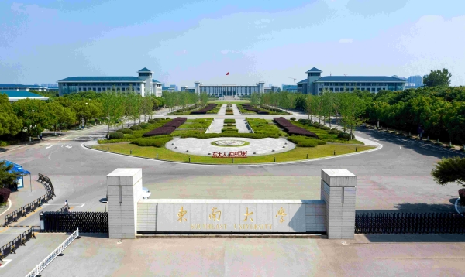


WELCOME SPEECH
Tao hansi

Slide 5
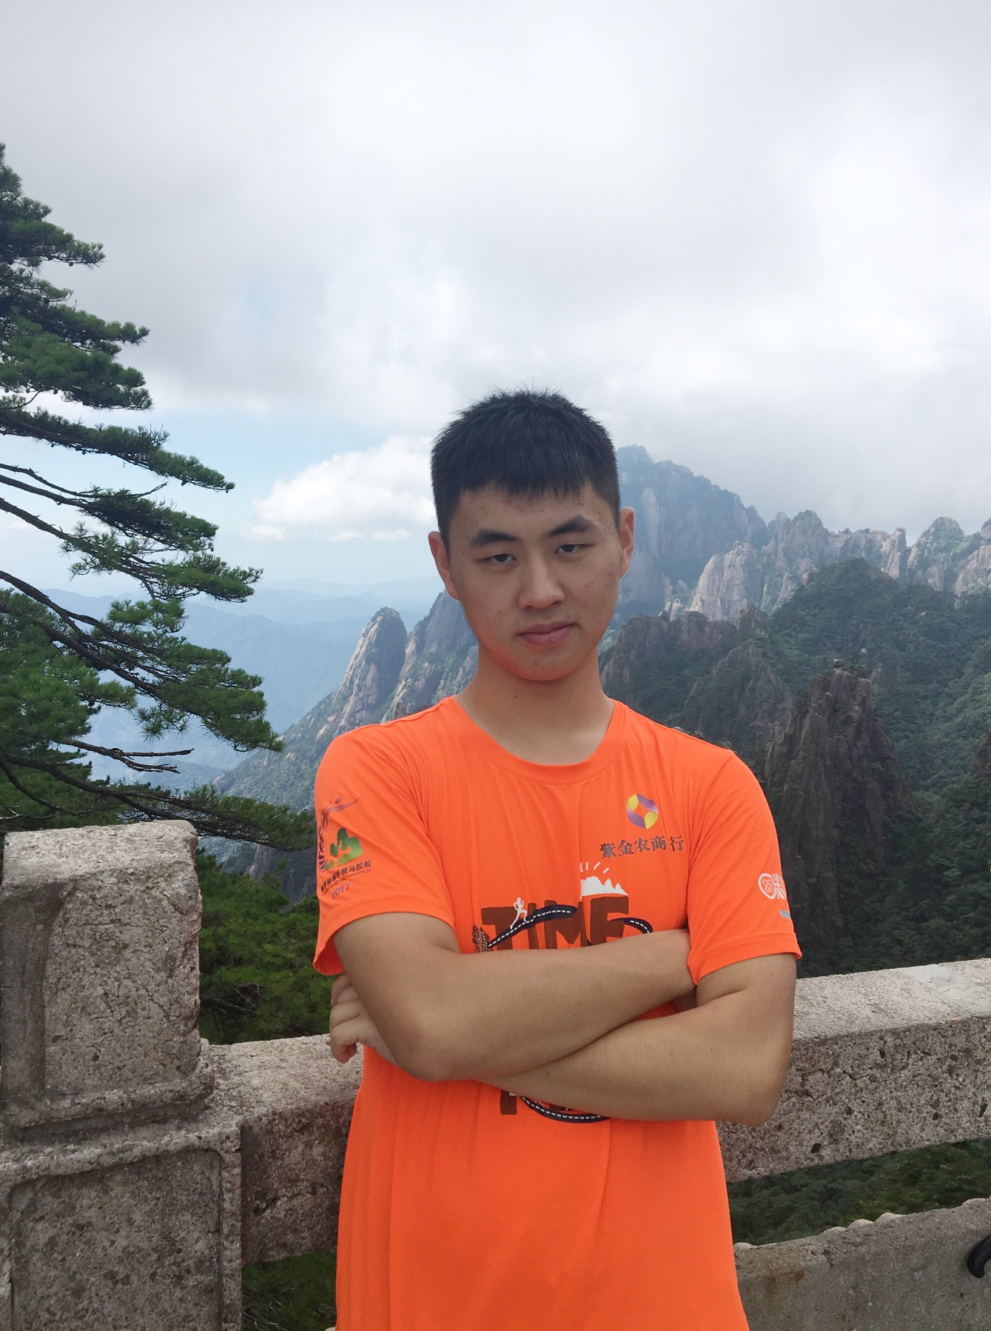
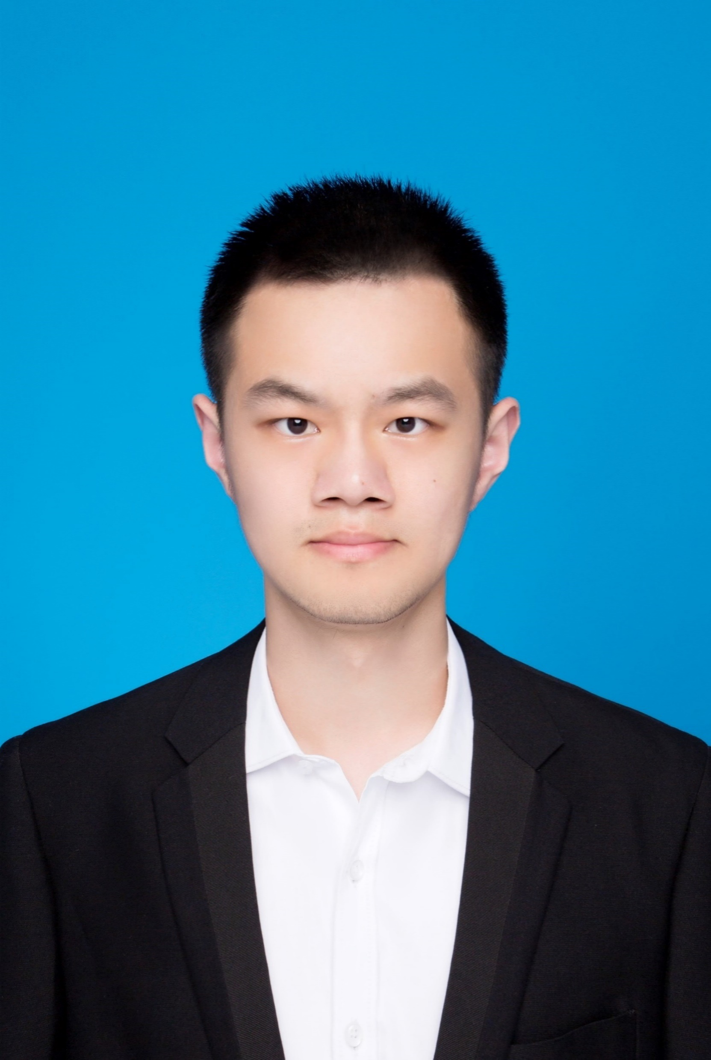
KEYNOTE SPEAKER
Kent Cheng (Xinyu Cheng)
Postgraduate, School of Computer Science, Southeast University
B.S. degree in Computer Science and Technology from Nanjing University of Posts and Telecommunications, China
Member of Southeast University-IBM Joint Cloud Computing Research Center
Howard Yin (Daheng Yin)
Postgraduate, School of Computer Science, Southeast University
B.S. degree in Internet of Things from Jiangnan University, China
Member of Southeast University-IBM Joint Cloud Computing Research Center

Slide 6
SDTCP: Towards Datacenter TCP Congestion Control with SDN for IoT Applications
Kent Cheng
Howard Yin
Southeast University, China

Slide 7
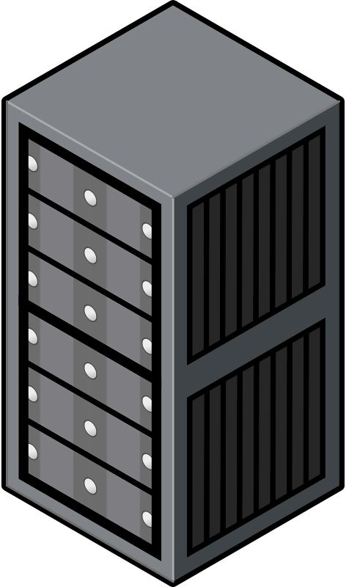

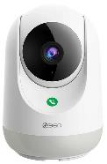
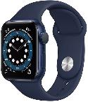

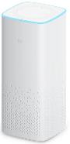

IoT Applications

Slide 8
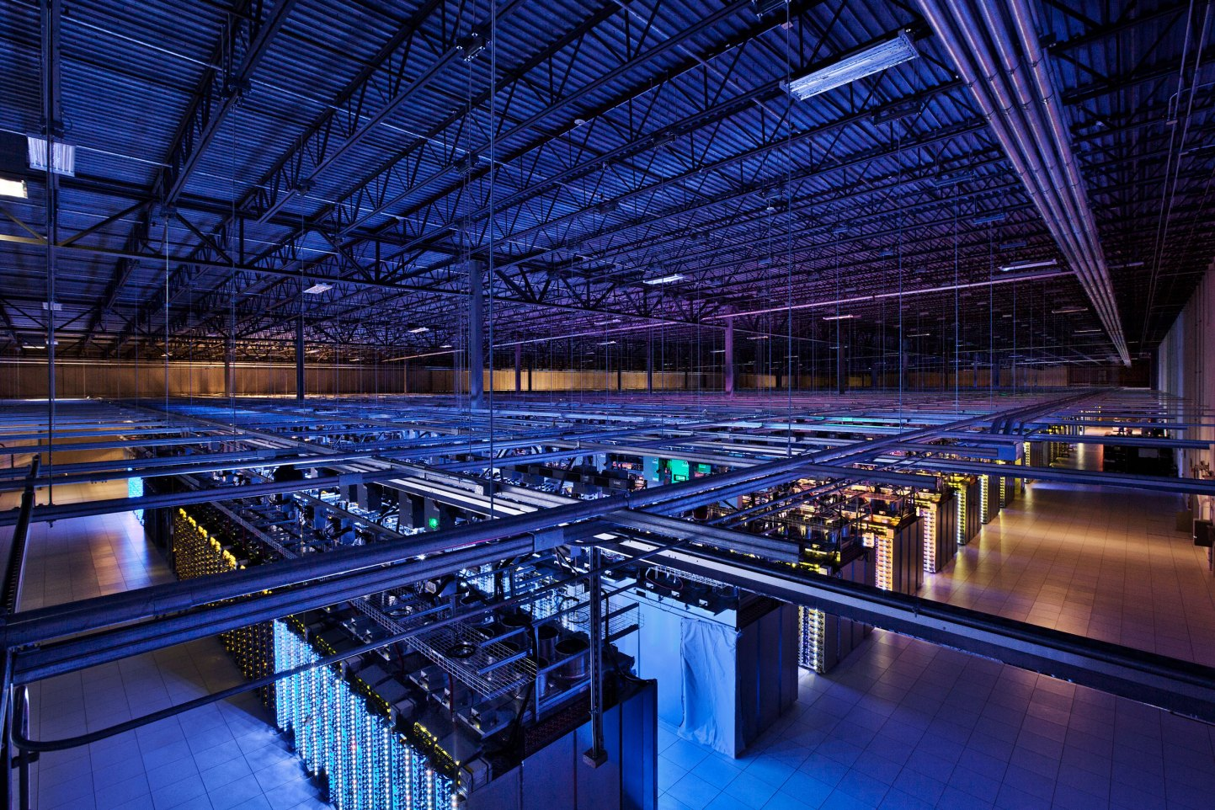
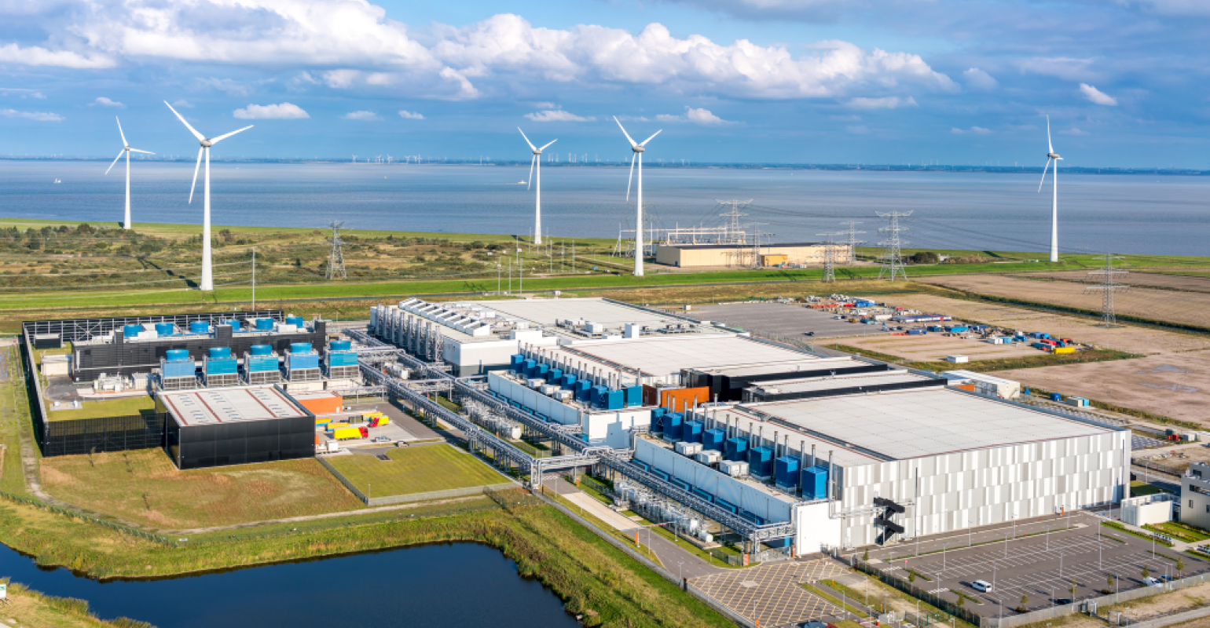
Data Center
Google's data center campus
in Eemshaven, Netherlands
A Google datacenter
in Council Bluffs, Iowa

Slide 9
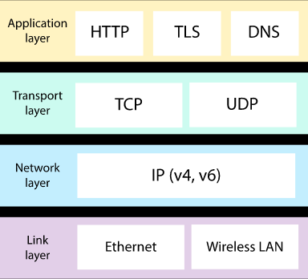
TCP in DCN
Internet
Border router
Load
balancer
Access router
Tier-1 switches
Tier-2 switches
TOR switches
Server racks
Schematic of DCN
Network Protocol Stack

Slide 10
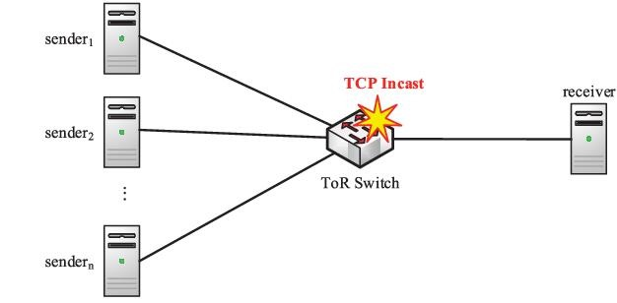

TCP Incast
 burst flows
low delay
 background flows
high throughput
delay-insensitive
TCP Incast Scenario

Slide 11
SDTCP Mechanism
Notes:
Hello everyone, I’ll introduce the SDTCP Mechanism and our experiment results.

Slide 12
Basic Principle of TCP used by SDTCP
Bandwidth is controlled by the size of slide window
Receiver change the slide window size according to ACK
SDTCP control the ACK so that control the bandwidth
Control
ACK
Slide window
Data to be sent
Send together
Notes:
The basic principle of the SDTCP is simple.
As we all know, in traditional TCP, the bandwidth is controlled by a slide window
And the slide window is controlled by a window size in ACK message
our SDTCP can control bandwidth by editing ACK messages.

Slide 13
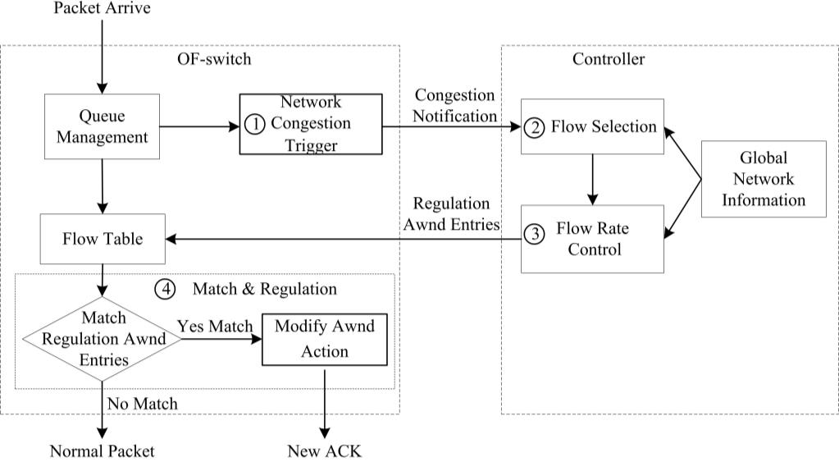
Step 1: Network Congestion Trigger
Detect Congestion
Count the length
Notes:
The first step is network congestion trigger.
We design a network congestion trigger module.
This module can counting the queue length in buffer to determine whether the network is congested.
The network is congested, it will send a congestion notification message to our controller.

Slide 14
Step 2: Flow Selection
Data from many other switch
Data collection & analysis
TTL, Flow size, IP address, TCP flows……
Data
Notes:
The second step is Flow Selection.
This module analyze all of the TCP flow information gained from switches.
With this information, it can detect background flow

Slide 15
Step 2: Flow Selection
Select all all of the background flows
Notes:
And when the module received a congestion notification message, it select all background flows.

Slide 16
Step 3: Flow Rate Control
congestion level
calculate a desired bandwidth
Notes:
Next step is Flow Rate Control.
In this step, flow selection module will tell the controller about the congestion level.
Then the controller will calculating a desired bandwidth depends on it.

Slide 17
Step 3: Flow Rate Control
Chosen Background flow
Send these entries to all switches
generates new flow table entries
Bandwidth
information
Notes:
, then the controller will generates new flow table entries according to current bandwidth information,
and send it to switches

Slide 18
Step 4: Flow Match and Regulation
Desired window size
Packets from other switch
Modify ACK
Receiver
Modify window size according to ACK
To Receiver
Notes:
When switches received the new entries, there is the final step Flow Match and Regulation.
Once ACK packets from the receiver match the entry at switch, the window size field of these packets will be modified.
After receiving these modified ACK packets, the sender will adjust the slide window into the desired size.
In this way, the bandwidth of background flows can be decreased to our desired one.

Slide 19
Experiment Results

Slide 20
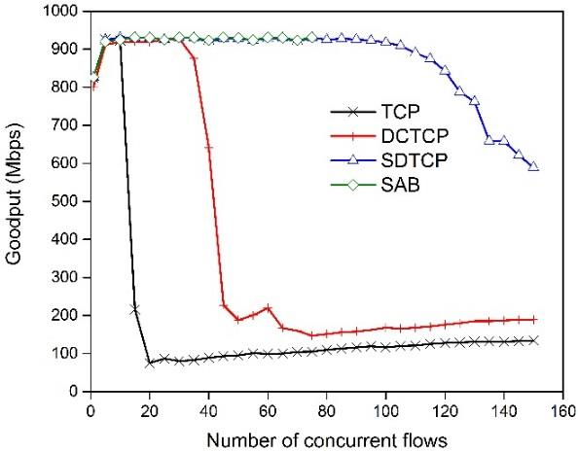
Experiment Results
Notes:
This figure shows the goodput of SDTCP, TCP, DCTCP, and SAB as we vary the number of concurrent flows from 1 to 150.
SDTCP can easily handle 100 concurrent flows and significantly improve the network performance over the incast scenario

Slide 21
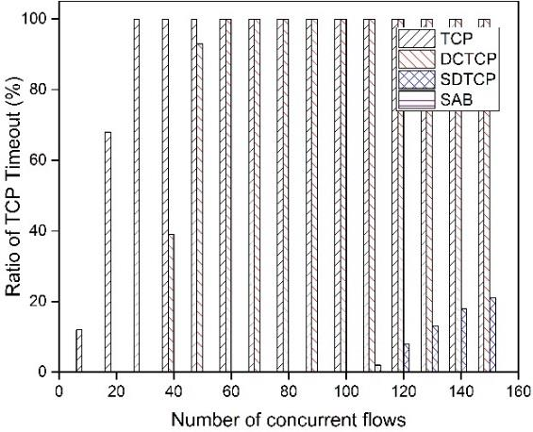
Experiment Results
Notes:
With the same experiment, we also present the timeout ratio for these protocols, as is shown in this figure.
We can see that timeout greatly decreased when performing SDTCP.

Slide 22
Summary
by adjusting the window size of TCP ACK packets
reduces the sending rate of background flows
guarantees high throughput for burst flows effectively
Notes:
With the same experiment, we also present the timeout ratio for these protocols, as is shown in this figure.
We can see that timeout greatly decreased when performing SDTCP.

Slide 23
Thanks for listening!
Notes:
Thank you for listening.

Slide 24
Q&A
Notes:
Now, please welcome back my colleague Kent, and feel free to ask any questions if you have.

Slide 25
CLOSING SPEECH
Wang Fan, President of INFOCOM

Slide 26
FAREWELL SPEECH
Tianchi Qiao, Vice President of INFOCOM

Slide 27
2020
Your participation and devotions are appreciated.

